Slide 1
Patch has a rant about dates and times

Slide 2
Really? Dates and times? Why?

Slide 3
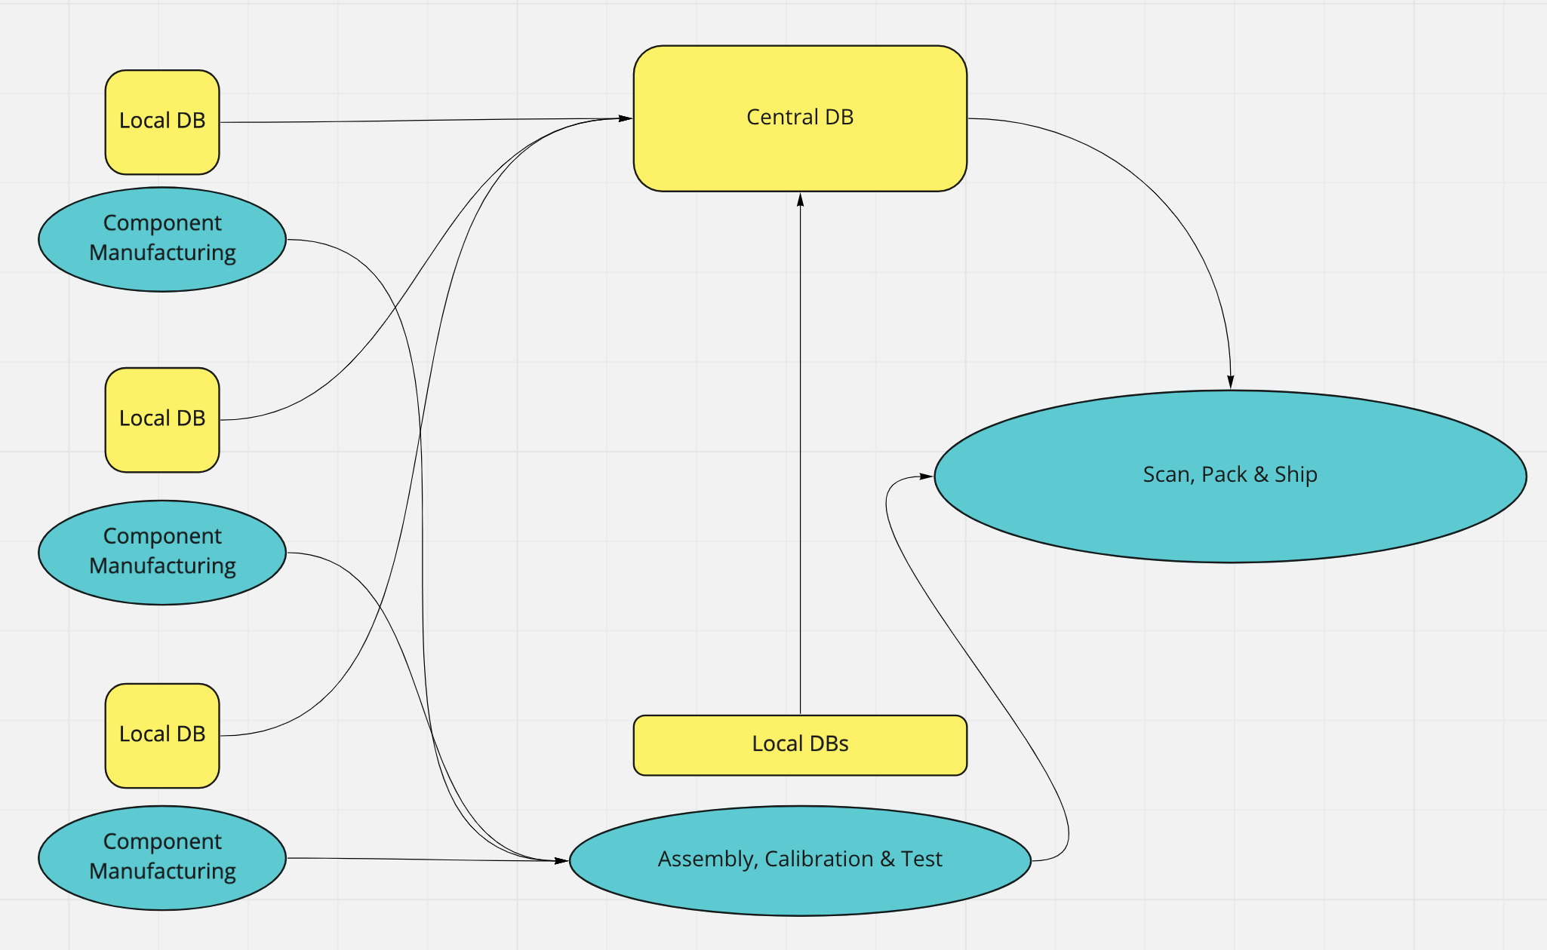
The most expensive bug I ever saw

Slide 4
DateTime.ToString(string) “DD-MMM-YYYY”
The most expensive bug I ever saw

Slide 5
* Since 1988, minor revisions post 2000 * Dates, Times, Durations * Most countries have adopted some form of ISO8601 * Why haven’t you used actual bullet points?
ISO 8601

Slide 6
* Sortable ordering * ‘YYYY-MM-DDTHH:mm:SS’ * Timezone Specifier (optional!) +01:00 / +0100 / Z * The presence or lack of a timezone specifier is significant
Dates & Times

Slide 7
* P (eriod) * n Y(ears) n M(onths) n D(ays) (Calendar months/years) * T(ime) n H(ours) n M(inutes) n S(econds) * eg. P2M3DT30M System.Xml.XmlConvert.ToTimespan(“P1DT6H”);
Time Periods / Durations

Slide 8
* Is an abstract point in time * Can only represent UTC, & local (not UTC) * No notion of where local is * DateTime.Kind Property (Utc/Local/Unspecified) * DateTime.Now vs DateTime.UtcNow
C# System.DateTime

Slide 9
* DateTime.ToString(”O”); -> Includes TZ * System.Text.Json -> ISO by default, but may drop TZ! * NewtonSoft Json.Net -> ISO with TZ
System.DateTime to ISO8601

Slide 10
* Has almost identical API to System.DateTime * Has a private DateTime field for the date and time * Has a private integer minutes offset field * Serializes with TZ, cannot parse without TZ * Does everything DateTime can do, and remove TZ ambiguity headaches
C# System.DateTimeOffset

Slide 11
* EntityFramework will always get a DateTime as DateTimeKind.Unspecified * SqlServer datetime column does not contain TZ info * SqlServer Docs recommend datetime2 for any new work
Other pitfalls to watch out for

Slide 12
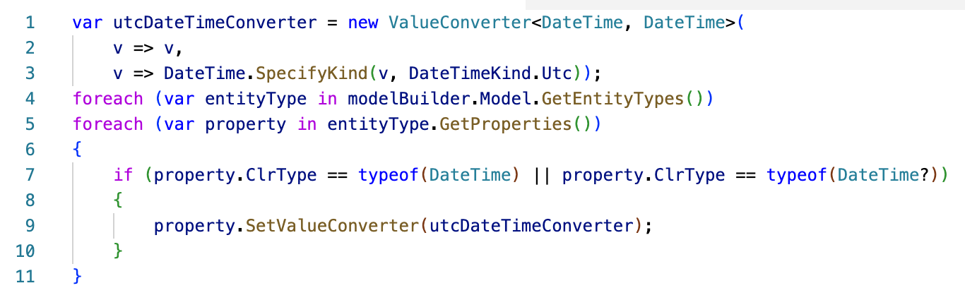
I don’t have time to change to DateTimeOffset!

Slide 13
* You don’t care about the time component * You only want to do abstract Date/Time math * Your dates and times do not cross application boundaries * You only intent to work in UTC * But you may as well use DateTimeOffset, the API and functionality is the same and if TZ ever becomes relevant, a whole class of bugs will not exist
When should I use System.DateTime?

Slide 14
Embrace DateTimeOffset
All Hail ISO8601

